Slide 1
CS2523 - Computer Organisation and Assembly Language
Exercises from 3rd Chap of Assembly Language Programming Lecture Notes – To solve Conditional Jumps & Unconditional Jumps related Problems

Slide 2
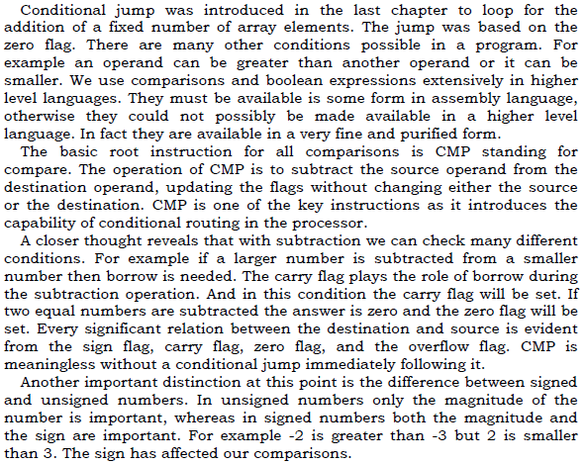
Comparisons And Conditions

Slide 3
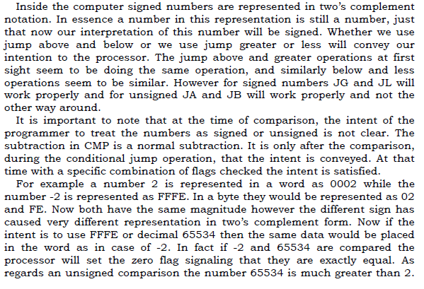
Comparisons And Conditions

Slide 4
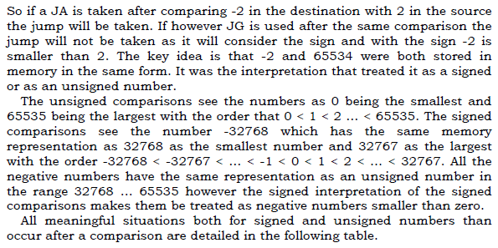
Comparisons And Conditions

Slide 5
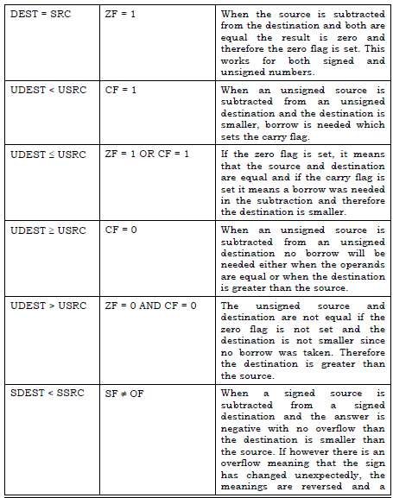
Comparisons And Conditions

Slide 6
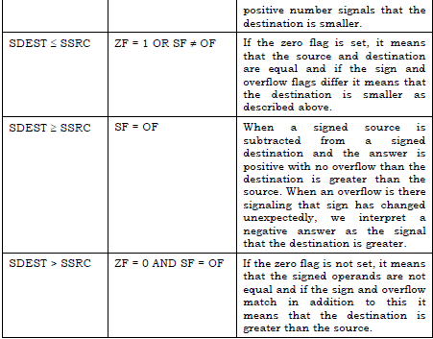
Comparisons And Conditions

Slide 7
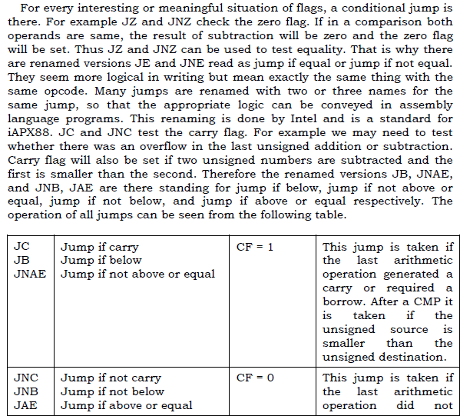
Conditional Jumps

Slide 8
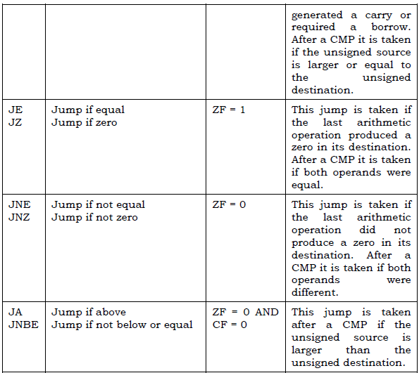
Conditional Jumps

Slide 9
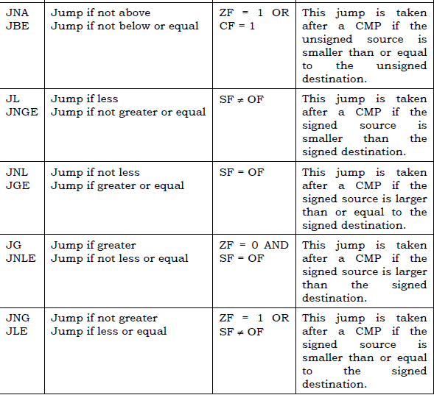
Conditional Jumps

Slide 10
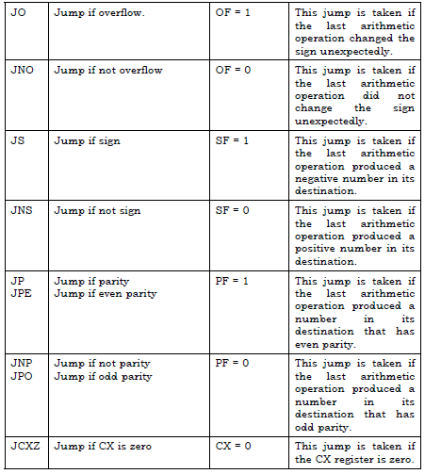
Conditional Jumps

Slide 11
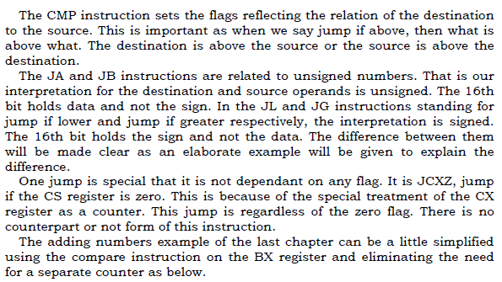
Conditional Jumps

Slide 12
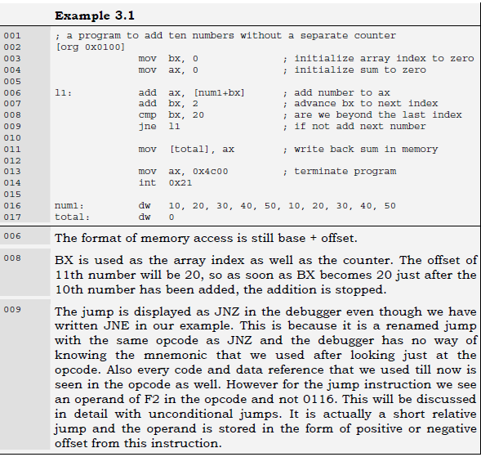
Conditional Jumps

Slide 13

Conditional Jumps

Slide 14
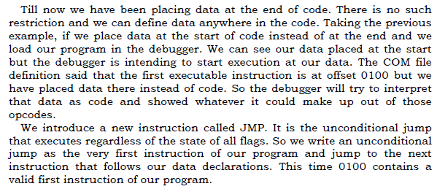
Unconditional Jumps

Slide 15
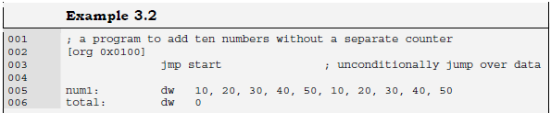
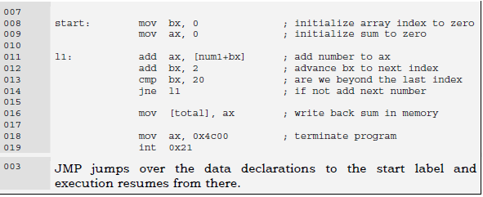
Unconditional Jumps

Slide 16
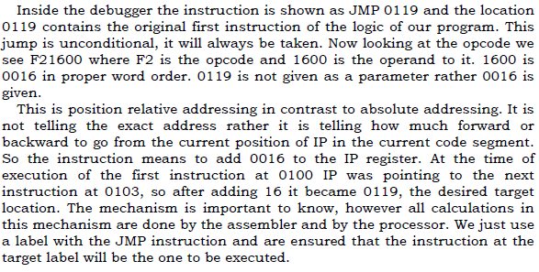
Relative Addressing

Slide 17
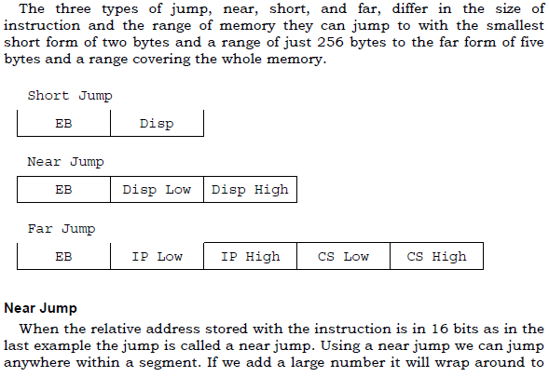
Types of Jump

Slide 18
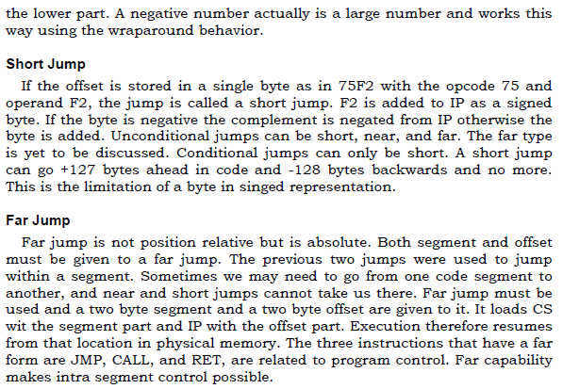
Types of Jump

